Slide 1
COMP 315 Introduction to OpenGL
Deshen Moodley
University of KwaZulu-Natal

Slide 2
Computer Graphics
Computer graphics deals with all aspects of creating images with a computer
Hardware
Software
Applications

Slide 3
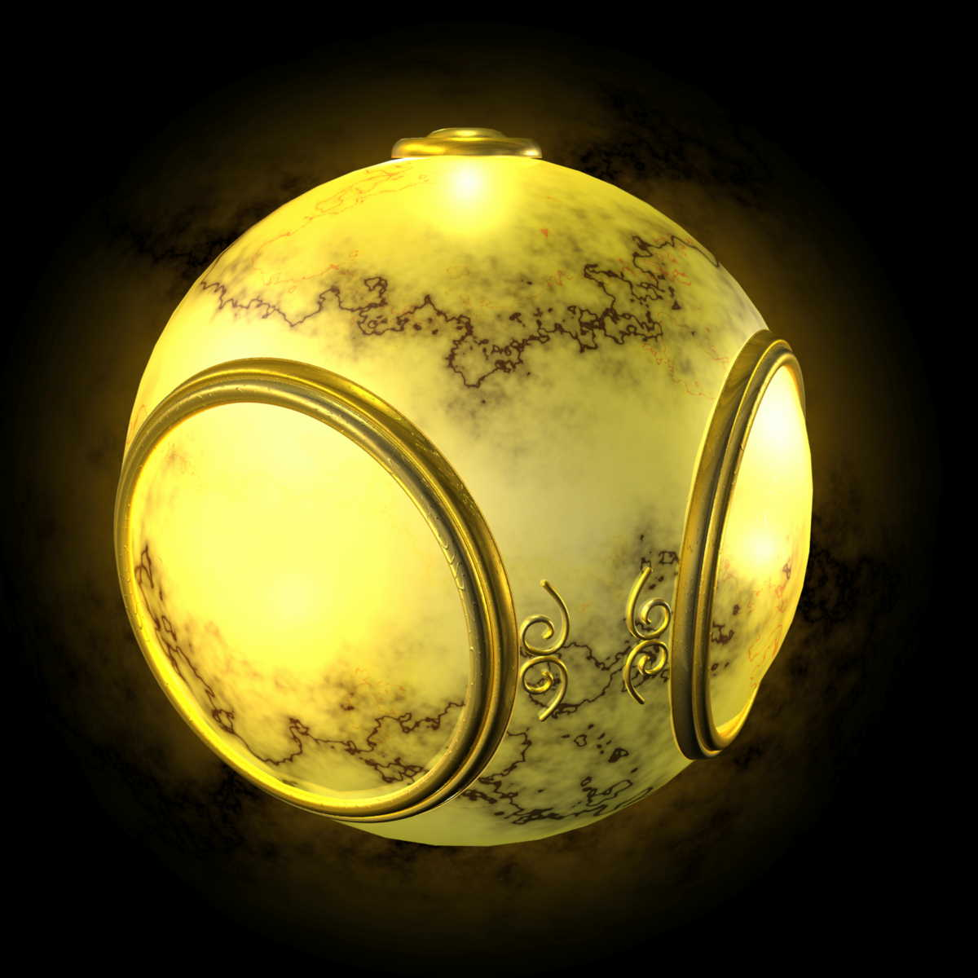
Example
Where did this image come from?
What hardware/software did we need to produce it?

Slide 4
Preliminary Answer
Application: The object is an artist’s rendition of the sun for an animation to be shown in a domed environment (planetarium)
Software: Maya for modeling and rendering but Maya is built on top of OpenGL
Hardware: PC with graphics card for modeling and rendering

Slide 5
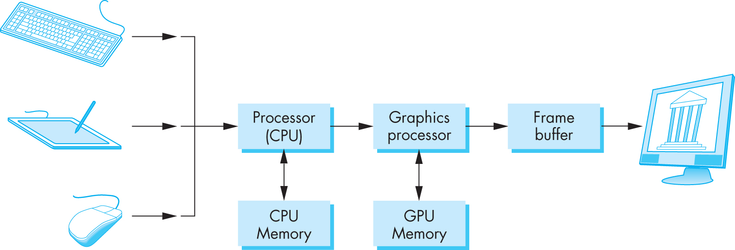
Basic Graphics System
Output device
Input devices
Image formed in frame buffer

Slide 6
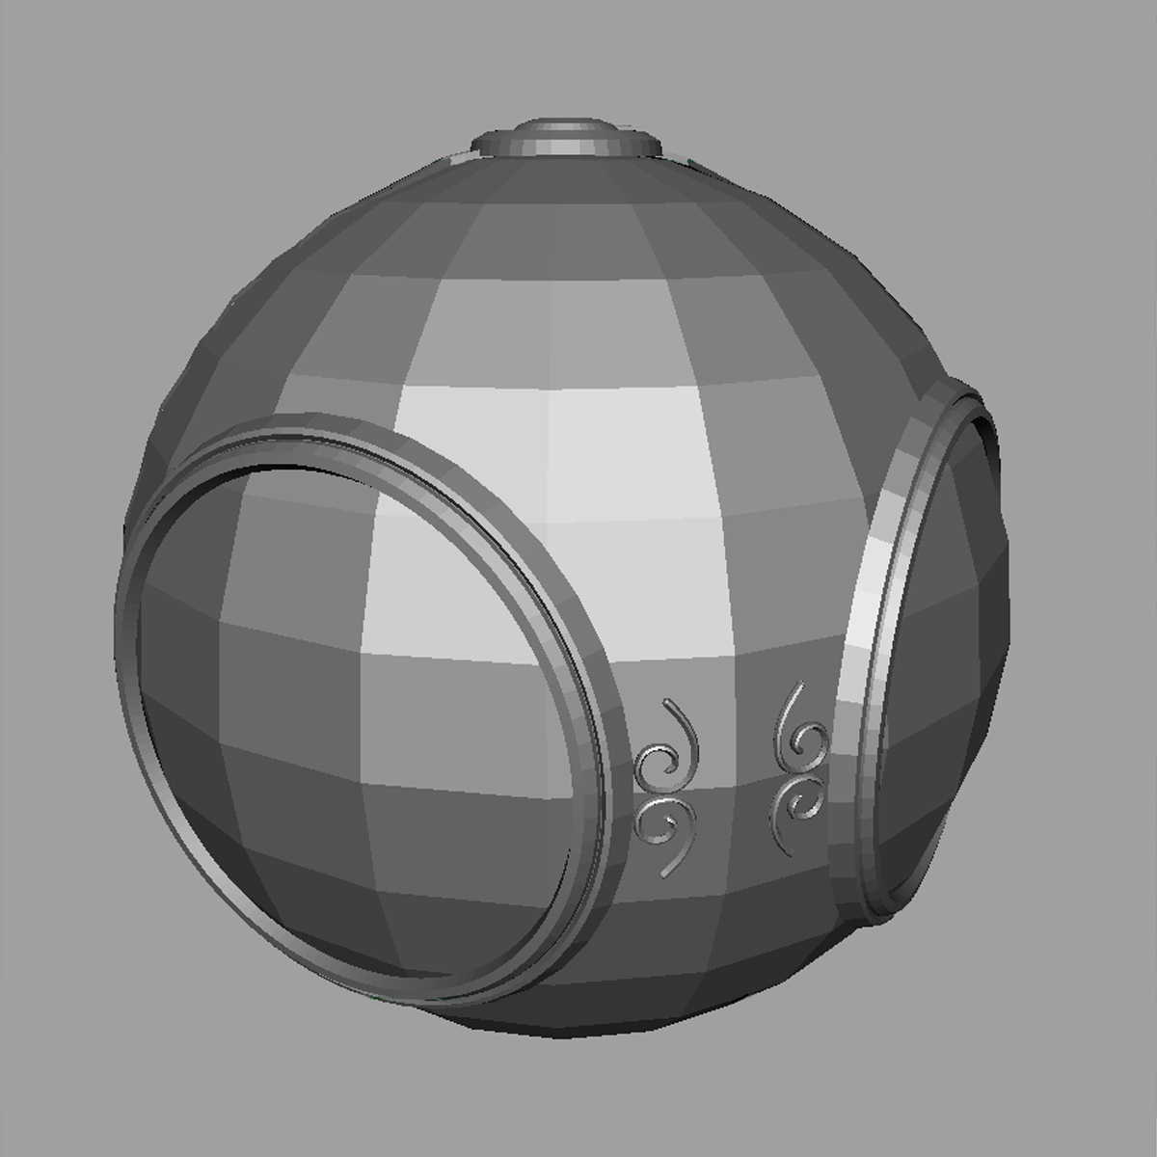
Raster Graphics
Allows us to go from lines and wire frame images to filled polygons

Slide 7
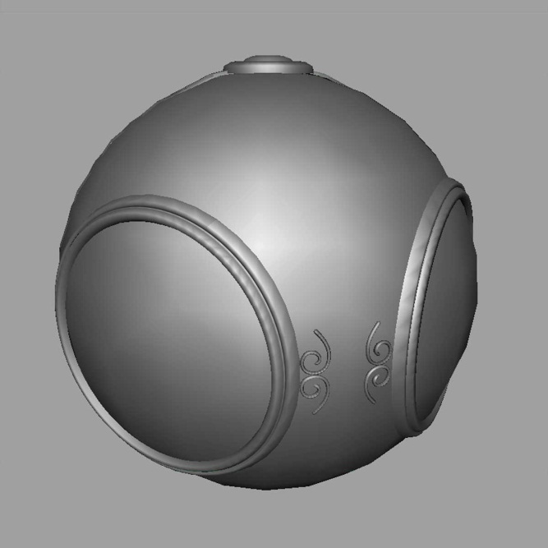
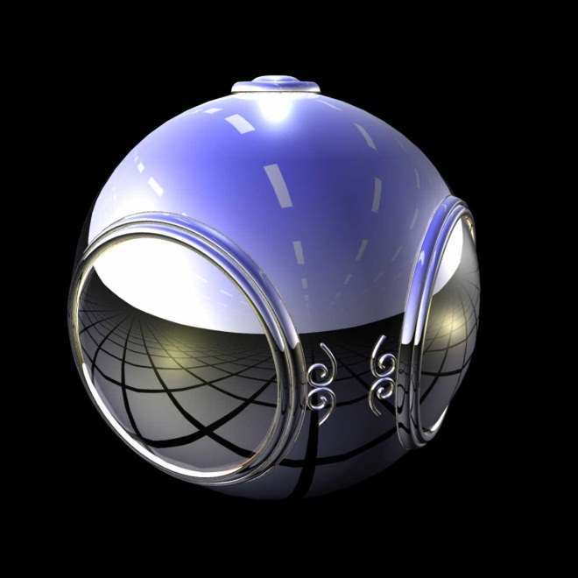
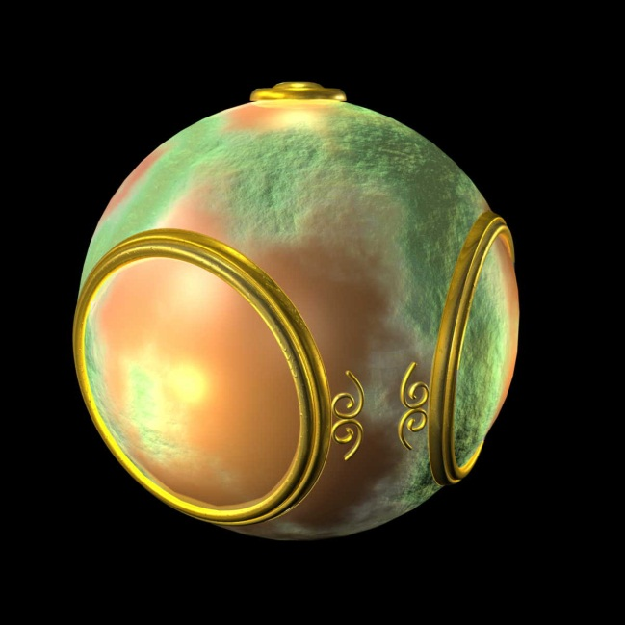
Computer Graphics: 1980-1990
Realism comes to computer graphics
smooth shading
environment
mapping
bump mapping

Slide 8
Computer Graphics: 1990-2000
OpenGL API
Completely computer-generated feature-length movies (Toy Story) are successful
New hardware capabilities
Texture mapping
Blending
Accumulation, stencil buffers

Slide 9
Application examples: Simulation and animation
The field of virtual reality (VR) has opened up many new horizons. A human viewer can be equipped with a display headset that allows her to see separate images with her right eye and her left eye so that she has the effect of stereoscopic vision.
In addition, her body location and position, possibly including her head and finger positions, are tracked by the computer. She may have other interactive devices available including force-sensing gloves and sound. She can then act as part of a computer generated scene, limited only by the image-generation ability of the computer. For example, a surgical intern might be trained to do an operation in this way, or an astronaut might be trained to work in a weightless environment.
Simulation and virtual reality have come together in many exciting ways in the film industry. Recently, stereo (3D) movies have become both profitable and highly acclaimed by audiences. Special effects created using computer graphics are part of virtually all movies, as are more mundane uses of computer graphics such as removal of artifacts from scenes.
Simulations of physics are used to create visual effects ranging from fluid flow to crowd dynamics.

Slide 10
Simulation and animation
Wire frame model of a wave, white water and spray using particle system and final composite image from the movie “Surf’s Up”
(Colour plate 14 from Shreiner and Angel)

Slide 11
Simulation and animation
One frame (left) from Pixar’s “Geri’s Game” showing refraction through reflections on Geri’s glasses. The reflection map (right) from the environment computed from the center of the lens on Geri’s glasses. The reflection map is then
mapped to the glasses as part of the rendering process. (Colour plate 23 from Shreiner and Angel)

Slide 12
Image formation models
Computer generated images are synthetic or artificial
In computer graphics a key concern is to construct two dimensional images representing a three dimensional world
Image formation however draws from two traditional optical systems
Optical system in a camera
Human visual system

Slide 13
Elements of image formation
Objects – exist independently in space
Constructed using positioned geometric primitives i.e. points, lines & polygons
Primitives are specified using a set of locations or vertices
a single vertex is necessary to specify a point
two vertices are necessary to specify a line
a polygon can be specified by an ordered list of vertices
( v₆ )
v₁
v₅
v₂
v₄
v₃

Slide 14
Example (traditional style)
type of object
location of vertex
glBegin(GL_POLYGON)
glVertex3f(0.0, 0.0, 0.0);
glVertex3f(0.0, 1.0, 0.0);
glVertex3f(0.0, 0.0, 1.0);
glEnd( );
end of object definition

Slide 15
Example (GPU based)
Put geometric data in an array
Send array to GPU
Tell GPU to render as triangle
vec3 points[3];
points[0] = vec3(0.0, 0.0, 0.0);
points[1] = vec3(0.0, 1.0, 0.0);
points[2] = vec3(0.0, 0.0, 1.0);

Slide 16
Elements of image formation
Viewer – perspective of viewing objects (scene) in a 3D world
Light source(s)
Attributes that govern how light interacts with the materials in the scene
Note the independence of the objects, the viewer, and the light source(s)

Slide 17
Light
Light is the part of the electromagnetic spectrum that causes a reaction in our visual systems
Generally these are wavelengths in the range of about 350-780 nm (nanometers)
Long wavelengths appear as reds and short wavelengths as blues

Slide 18
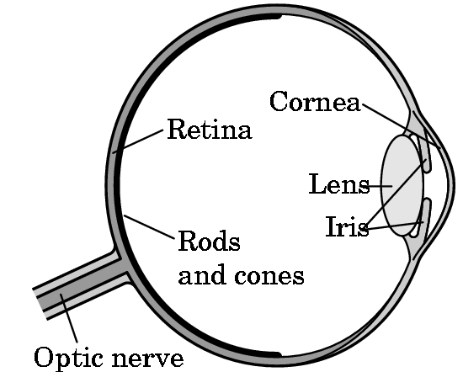
Three-Color Theory
Human visual system has two types of sensors
Rods: monochromatic, night vision
Cones
Color sensitive
Three types of cones (red, green & blue)
Only three values (the tristimulus
values) are sent to the brain
Need only match these three values
Need only three primary colors

Slide 19
Pinhole Camera
The pin hole camera only allows a single ray of emanating from a point to enter it. The ray hits the back plane of the camera. The point at which it hits, i.e. (x_{p} , y_{p} , z_{p} ) is called the projection of point (x, y, z)
Use trigonometry (similar triangles) to find projection of the point at (x,y,z)
x_{p}= -x/z/d
y_{p}= -y/z/d
z_{p}= d
These are equations of simple perspective

Slide 20
Image Formation Revisited
Using the synthetic camera model as the basis, we can design a computer graphics system
The Application Programmer Interface (API) need only specify constructs to manage:
Objects
Materials
Viewer
Lights
But how is the API implemented?

Slide 21
Practical Approach
Process objects one at a time in the order they are generated by the application
Can consider only local lighting
Pipeline architecture
All steps can be implemented in hardware on the graphics card
application
program
display

Slide 22
Vertex Processing
Much of the work in the pipeline is in converting object representations from one coordinate system to another
Object coordinates
Camera (eye) coordinates
Screen coordinates
Every change of coordinates is equivalent to a matrix transformation
The vertex processor also computes vertex colors

Slide 23
Projection
Projection is the process that combines the 3D viewer with the 3D objects to produce the 2D image
Perspective projections: all projectors meet at the center of projection
Parallel projection: projectors are parallel, center of projection is replaced by a direction of projection

Slide 24
Primitive Assembly
Vertices must be collected into geometric objects before clipping and rasterization can take place
Line segments
Polygons
Curves and surfaces

Slide 25
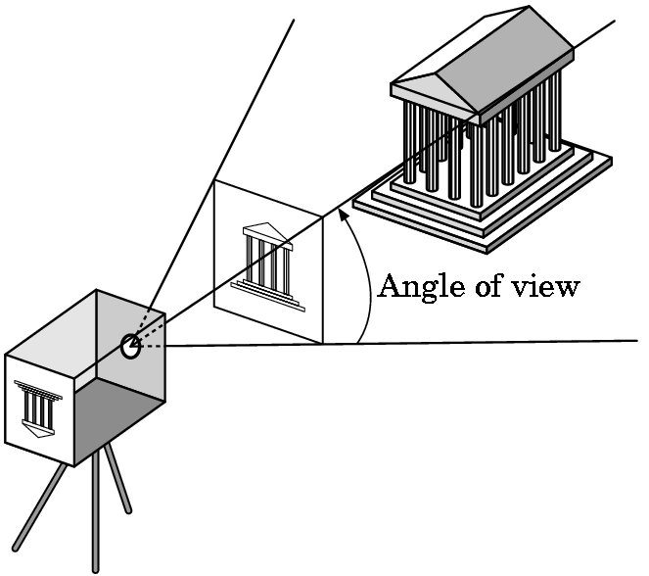
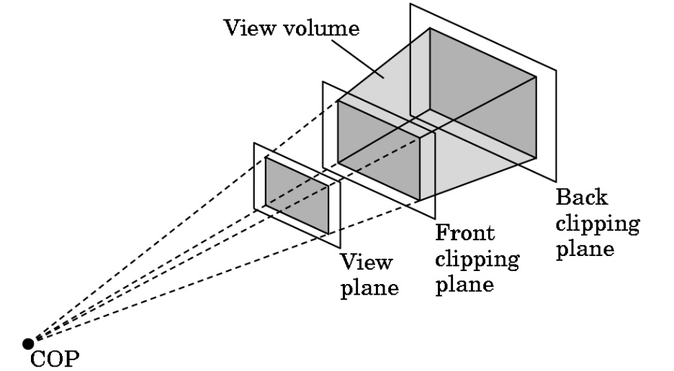
Clipping
Just as a real camera cannot “see” the whole world, the virtual camera can only see part of the world or object space
Objects that are not within this volume are said to be clipped out of the scene

Slide 26
Rasterization
If an object is not clipped out, the appropriate pixels in the frame buffer must be assigned colors
Rasterizer produces a set of fragments for each object
Fragments are “potential pixels”
Have a location in frame buffer
Color and depth attributes
Vertex attributes are interpolated over objects by the rasterizer

Slide 27
Fragment Processing
Fragments are processed to determine the color of the corresponding pixel in the frame buffer
Colors can be determined by texture mapping or interpolation of vertex colors
Fragments may be blocked by other fragments closer to the camera
Hidden-surface removal

Slide 28
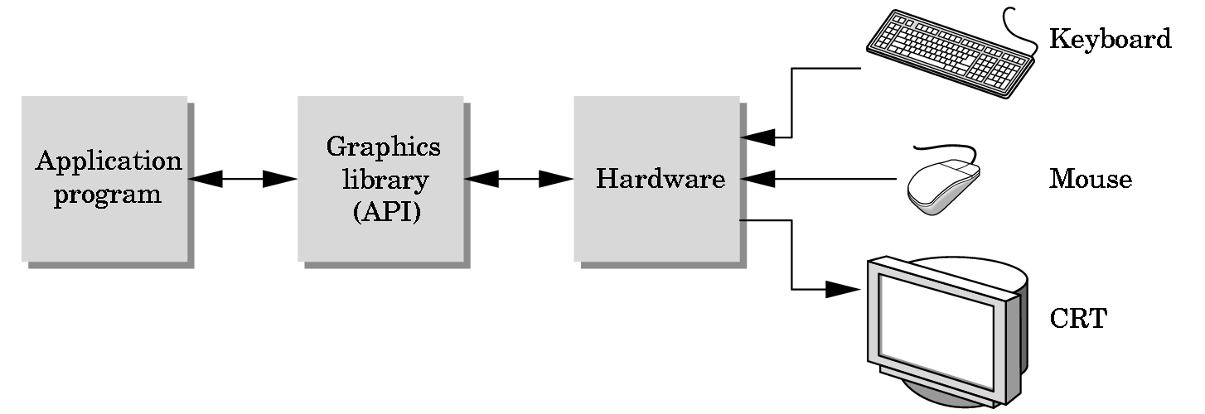
The Programmer’s Interface
Programmer sees the graphics system through a software interface: the Application Programmer Interface (API)

Slide 29
API Contents
Functions that specify what we need to form an image
Objects
Viewer
Light Source(s)
Materials
Other information
Input from devices such as mouse and keyboard
Capabilities of system

Slide 30
OpenGL
Open Graphics Library (OpenGL) is an application programming interface (API) giving application developers access to hardware accelerated 3D & 2D rendering
OpenGL 1.x first released by Silicon Graphics Inc. (SGI) in January 1992, and has constantly evolved – latest version: OpenGL 4.4 (July 2013)
An independent consortium, the OpenGL Architecture Review Board, guides the OpenGL specification
OpenGL has broad industry support, and is the only open, vendor-neutral, multiplatform graphics standard
See:
http://www.opengl.org/about/

Slide 31
Programming in OpenGL
OpenGL has default support in many languages, historically in C++
Is independent of any windowing system – the OpenGL Utility Toolkit (GLUT) traditionally used in C++
But there are many other alternatives

Slide 32
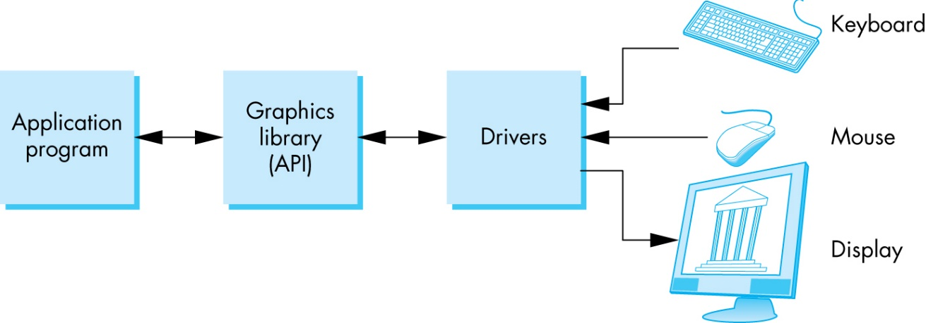
OpenGL Architecture

Slide 33
OpenGL Functions
Primitives
Points
Line Segments
Triangles, Polygons
Attributes
Transformations
Viewing
Modeling
Control (GLUT)
Input (GLUT)
Query – information about the hardware/environment

Slide 34
OpenGL State
OpenGL is a state machine
OpenGL functions are of two types
Primitive generating
Can cause output if primitive is visible
How vertices are processed and appearance of primitive are controlled by the state
State changing
Transformation functions
Attribute functions
Under 3.1 most state variables are defined by the application and sent to the shaders

Slide 35
Lack of Object Orientation
OpenGL is not object oriented so that there are multiple functions for a given logical function
glUniform3f
glUniform2i
glUniform3dv
Underlying storage mode is the same
Easy to create overloaded functions in C++ but issue is efficiency

Slide 36
OpenGL function format
function name
dimensions
glUniform3f(x,y,z)
x,y,z are floats
belongs to GL library
glUniform3fv(p)
p is a pointer to an array

Slide 37
OpenGL constants
There are many global OpenGL constants that are routinely used
Examples
glEnable(GL_DEPTH_TEST)
glClear(GL_COLOR_BUFFER_BIT)

Slide 38
OpenGL and GLSL
OpenGL was historically based on fixed function calls: primitives and attributes, recent versions are based on Shaders
A Shader is a program (set of instructions) designed to run on some stage of a graphics processor
A Shader executes one of the programmable stages of the rendering pipeline
Shader based OpenGL is based less on a state machine model than a data flow model
Most state variables, attributes and related pre 3.1 OpenGL functions have been deprecated
Action happens in shaders and the job of application is to get data to GPU
We will be using OpenGL 2.0 and NOT shaders

Slide 39
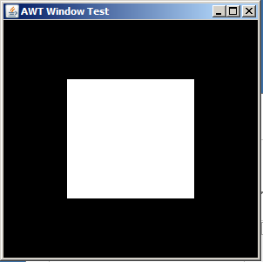
A Simple Program (?)
Generate a square on a solid background

Slide 40
Fixed function programming
// Set background color to black and opaque
glClearColor(0.0f, 0.0f, 0.0f, 1.0f);
// Clear the color buffer (background)
glClear(GL_COLOR_BUFFER_BIT);
// Draw a Red 1x1 Square centered at origin
glBegin(GL_QUADS);
// Each set of 4 vertices form a quad
glColor3f(1.0f, 0.0f, 0.0f); // Red
glVertex2f(-0.5f, -0.5f); // x, y
glVertex2f( 0.5f, -0.5f);
glVertex2f( 0.5f, 0.5f);
glVertex2f(-0.5f, 0.5f);
glEnd();

Slide 41
Object Specification
Most APIs support a limited set of primitives including
Points (0D object)
Line segments (1D objects)
Polygons (2D objects)
Some curves and surfaces
Quadrics
Parametric polynomials
All are defined through locations in space or vertices
GL05IdleFunc.cpp

Slide 42
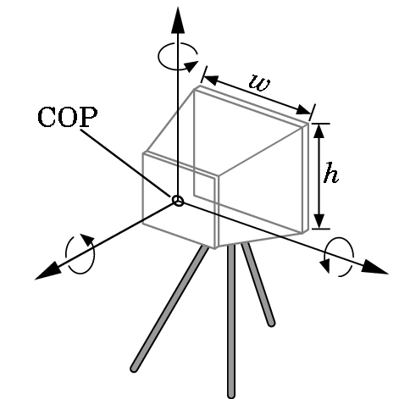
Camera Specification
Position: The camera location usually is given by the position of the center of the lens or center of projection (COP)
Orientation: Once we have positioned the camera, we can place a camera coordinate system with its origin at the COP. We can then rotate the camera independently around the three axes of this system.
Focal length: The focal length of the lens determines the size of the image on the film plane or, equivalently, the portion of the world the camera sees (field of view) (w, h)
Film plane (optional): The back of the camera has a height and a width. On the bellows camera, and in some APIs, the orientation of the back of the camera can be adjusted independently of the orientation of the lens.

Slide 43
Camera Specification
Generally has six degrees of freedom
Position of center of lens (COP)
Orientation (rotation along x, y, z axes)
Field of view (h,w)

Slide 44
Lights and Materials
Types of lights
Point sources vs distributed sources
Spot lights
Near and far sources
Color properties
Material properties
Absorption: color properties
Scattering
Diffuse
Specular

